Slide 1
Lecture 11:
Basic Concepts of Wavefront Reconstruction
Astro 289
Rebecca Jensen-Clem
February 13, 2020
Based on slides by Claire Max, Marcos van Dam, Lisa Poyneer
the CfAO Summer School, and the hcipy PYWFS tutorial

Slide 2
What is wavefront reconstruction?
Most wavefront sensors do not measure the phase directly, but instead measure the average derivative
Most wavefront correctors are used to conjugate that phase on the mirror’s surface
We must reconstruct the phase from the WFS slopes, achieving the most accurate, lowest noise estimate possible in the least amount of computation

Slide 3
Method 1: Zonal Matrix Reconstruction
The slope vector s contains x and y slopes for all valid subapertures in the pupil
The phase ɸ contains all controllable actuators
The basis set for reconstruction is the actuators
We model the WFS measurement process as:
We can find the measurement matrix W experimentally

Slide 4
Experimental system matrix
Poke one actuator at a time in the positive and negative directions and record the WFS centroids
Set WFS centroid values from subapertures far away from the actuators to 0

Slide 5
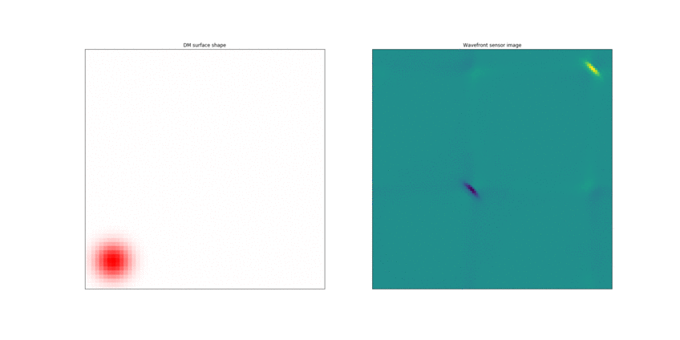
Experimental system matrix
DM surface shape
WFS image
We’re left with a # pokes by # pixels matrix, which we’re calling W

Slide 6
Method 1: Zonal Matrix Reconstruction
Given the matrix W, we can convert phases to slopes via s = W ɸ
In reality, we’ll be measuring slopes with our WFS, and we’ll want to use those slopes to estimate the phase via ɸ = W⁻¹ s
W isn’t square, so we’ll compute the inverse using LS:
Unfortunately, W^{T}W isn’t invertible either –- it doesn’t have full rank because the WFS is blind to some modes

Slide 7
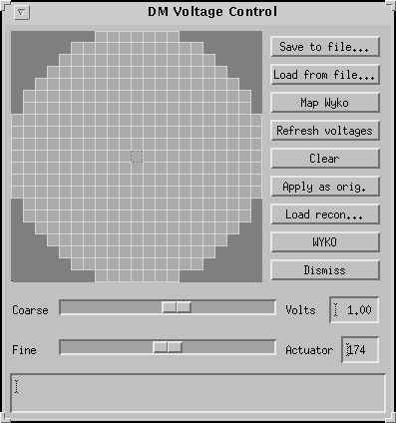
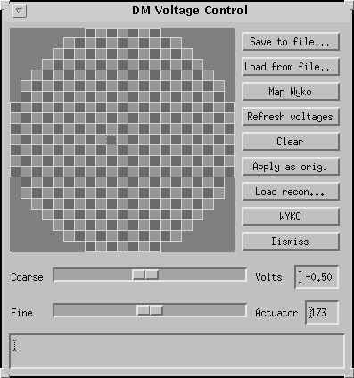
Method 1: Zonal Matrix Reconstruction
Two invisible modes are piston and waffle:
Instead we’ll compute the pseudo-inverse of W using singular value decomposition (SVD), giving us an expression for ɸ = W† s

Slide 8
Singular-Value Decomposition (SVD)
If A is a square matrix, we can write:
Where is a non-zero vector (the eigenvector) and is a scalar (the eigenvalue)
If A is not square, we can equivalently compute the eigenvectors of A^{T}A. These are called the singular vectors of A
The square roots of the eigenvalues of A^{T}A are called the singular values of A

Slide 9
Singular-Value Decomposition (SVD)
If W is a real m x n matrix, we can represent it as:
U is an m x m matrix while columns are the eigenvectors of WW^{T}
Σ is an m x n diagonal matrix whose diagonal values are the singular values of W
V^{T} is the transpose of an n x n matrix whose columns are the eigenvectors of W^{T}W

Slide 10
Calculating the Pseudoinverse with SVD
Given , the pseudo inverse of W is:
Where † is the pseudoinverse
The pseudoinverse of Σ is just a diagonal matrix whose diagonal elements are the reciprocal of Σ’s diagonal elements

Slide 11
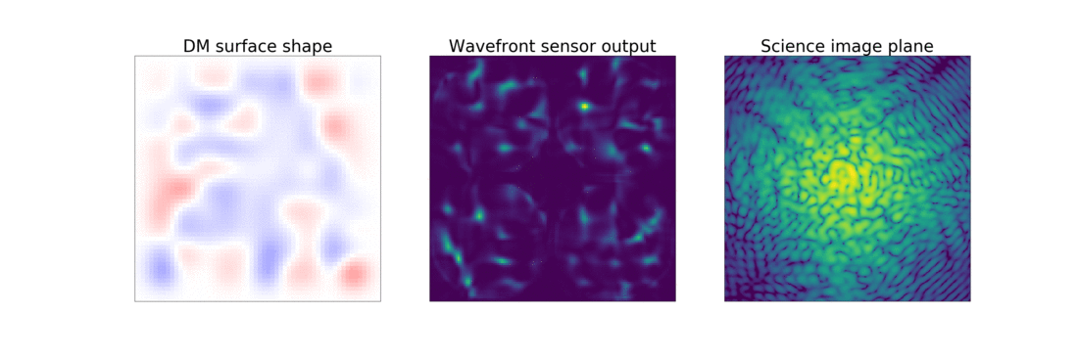
Method 1: Zonal Matrix Reconstruction
With the reconstruction matrix we found previously, we can reconstruct an example wavefront!
DM_acts_{t}= (1-leakage) DM_acts_{t-1} – gain(W† ⋅ WFS image_{t-1})
In this “leaky integrator” example, leakage = 0.01 and gain = 0.5

Slide 12
“Slaved” actuators
Some actuators are located outside the pupil and do not directly affect the wavefront
They are often “slaved” to the average value of its neighbors

Slide 13
Method 2: Modal Matrix Reconstruction
We define an orthogonal modal basis set to represent the actuators: ⟨m_{k}, m_{l}⟩ = 0 for k ≠ l

Slide 14
Examples of modal basis sets

Slide 15
Method 2: Modal Matrix Reconstruction
We define an orthogonal modal basis set to represent the actuators: ⟨m_{k}, m_{l}⟩ = 0 for k ≠ l
We can analyze the phase in terms of modal coefficients with the inner product c_{k} = ⟨ɸ, m_{k}⟩
The phase is synthesized from the modal coefficients as
We can put the modes into rows or columns to produce the modal synthesis matrix M

Slide 16
Method 2: Modal Matrix Reconstruction
Now, the slope measurement process is:
And the modal reconstruction is:
An advantage of modes is that they can be weighted and manipulated. E.g. we can easily remove piston, tip, and tilt from Zernike modes by zeroing the correct coefficients using matrix G:

Slide 17
Keck II PYWFS Latency
1.41 kHz detector readout
Slide credit: Sylvain Cetre
WF reconstruction & control don’t happen instantaneously!
issue DM
command
Software +
electronics
latency
124us
½ exp.
DM
physical
latency:
Frame demand
310ns
250us
Camera exposure: 709us
Camera exposure
Camera exposure
Readout: 709us
Transfer, decoding: 171us
Processing: 27.44us
Latency = 1.567 ms

Slide 18
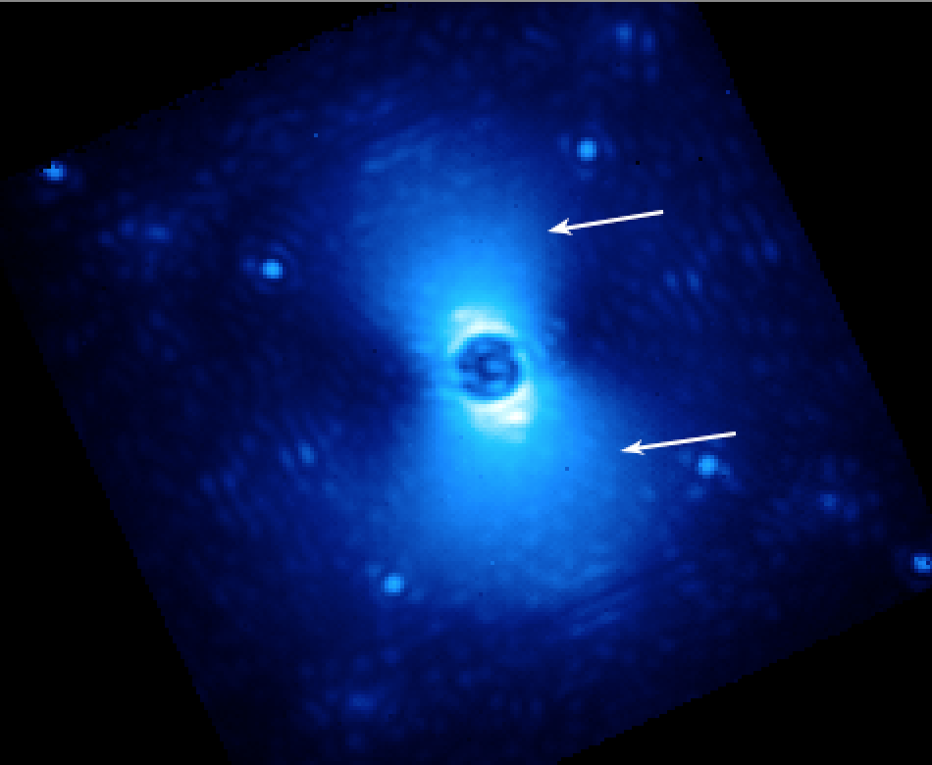
When the atmospheric coherence time is short compared with the AO system’s speed, we start to see effects like the “butterfly”
Perrin/Maire/GPI Data Analysis Team
See also Madurowicz+18,19

Slide 19
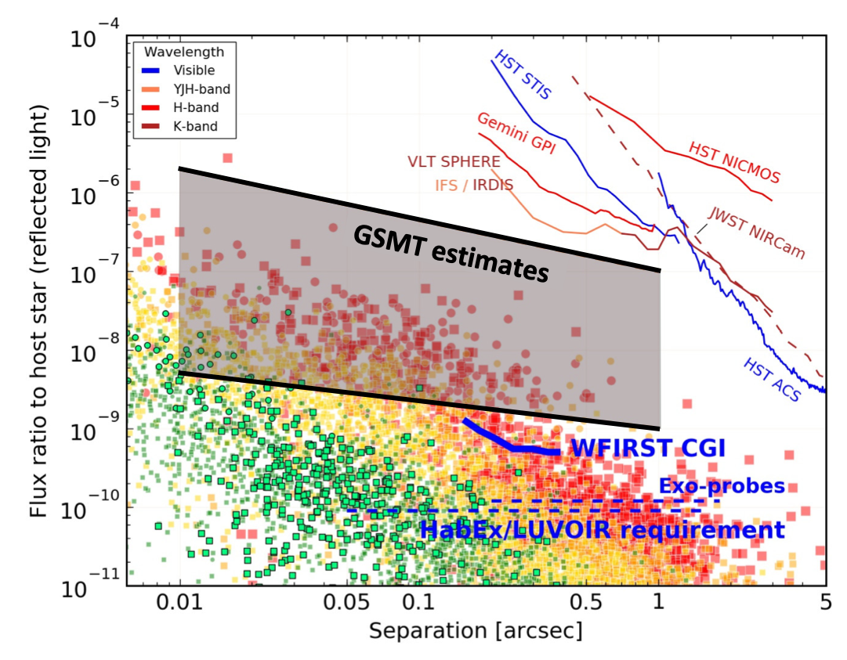
NAS ESS Report 2018

Slide 20
Predictive Wavefront Control
Several methods for predictive control have been proposed since the 1990s, e.g. Fourier predictive control (Poyneer et al. 2007, 2008) and Empirical Orthogonal Functions (Guyon & Males 2017)
Each method has a different way of computing the WF one time delay into the future based on past WF information
Each method makes different assumptions about the data and the atmosphere

Slide 21
Guyon & Males 2017: put the n most recent wavefronts into a “history” vector h(t)
Notes:
1) A single wavefront consists of m measurements. Let’s put the last n wavefronts into a history vector:

Slide 22
Guyon & Males 2017: find a filter F that minimizes the distance between F h(t) and the future wavefront ω(t+δt)
Notes:
2) We want to find the filter that minimizes the distance between the predicted and actual future wavefront:

Slide 23
Guyon & Males 2017: to compute the filter F, we’ll use a “training set” of previous history vectors, D, and interpolate to find the corresponding training set P shifted one time delay later
Matrix of History Vectors:
Matrix of “Future” Vectors: is the time lag

Slide 24
Guyon & Males 2017: use SVD to solve for the filter in terms of the training set
Notes:
2) We want to find the filter that minimizes the distance between the predicted and actual future wavefront:

Slide 25
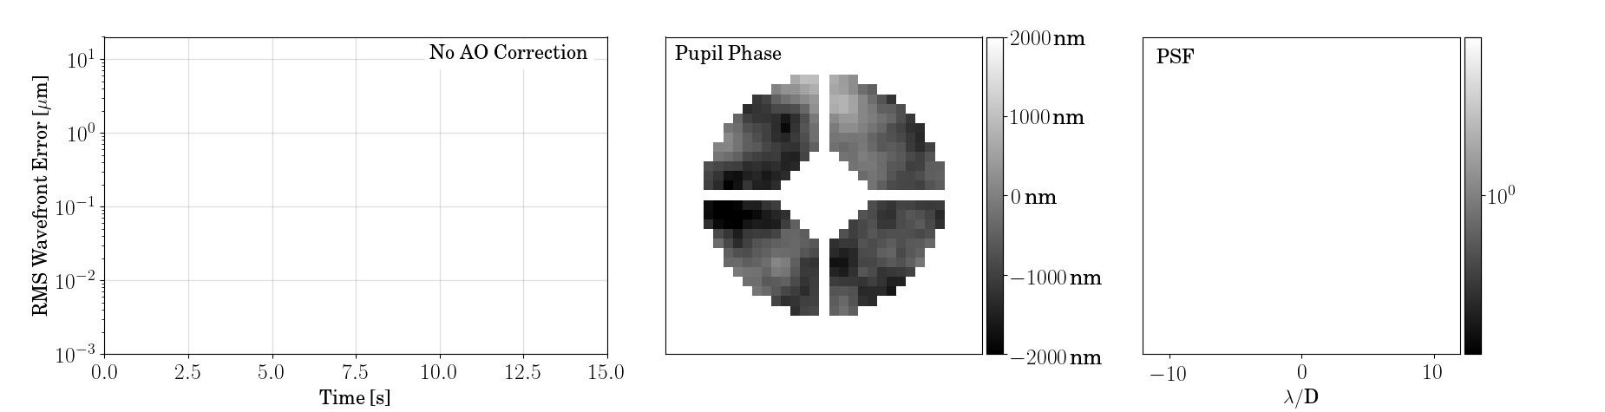
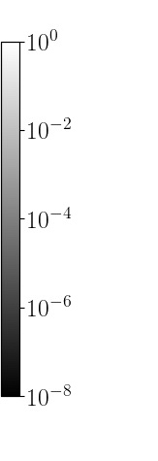
Guyon & Males 2017: how well does it work in a simple frozen flow simulation?

Slide 26
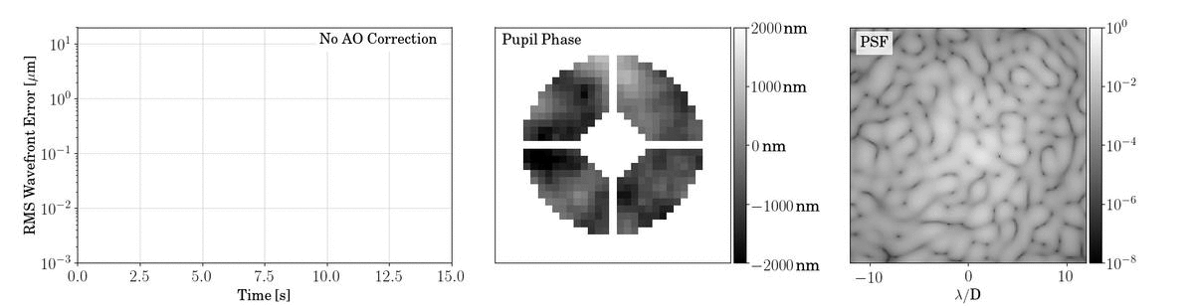
Guyon & Males 2017: how well does it work in a simple frozen flow simulation?

Slide 27
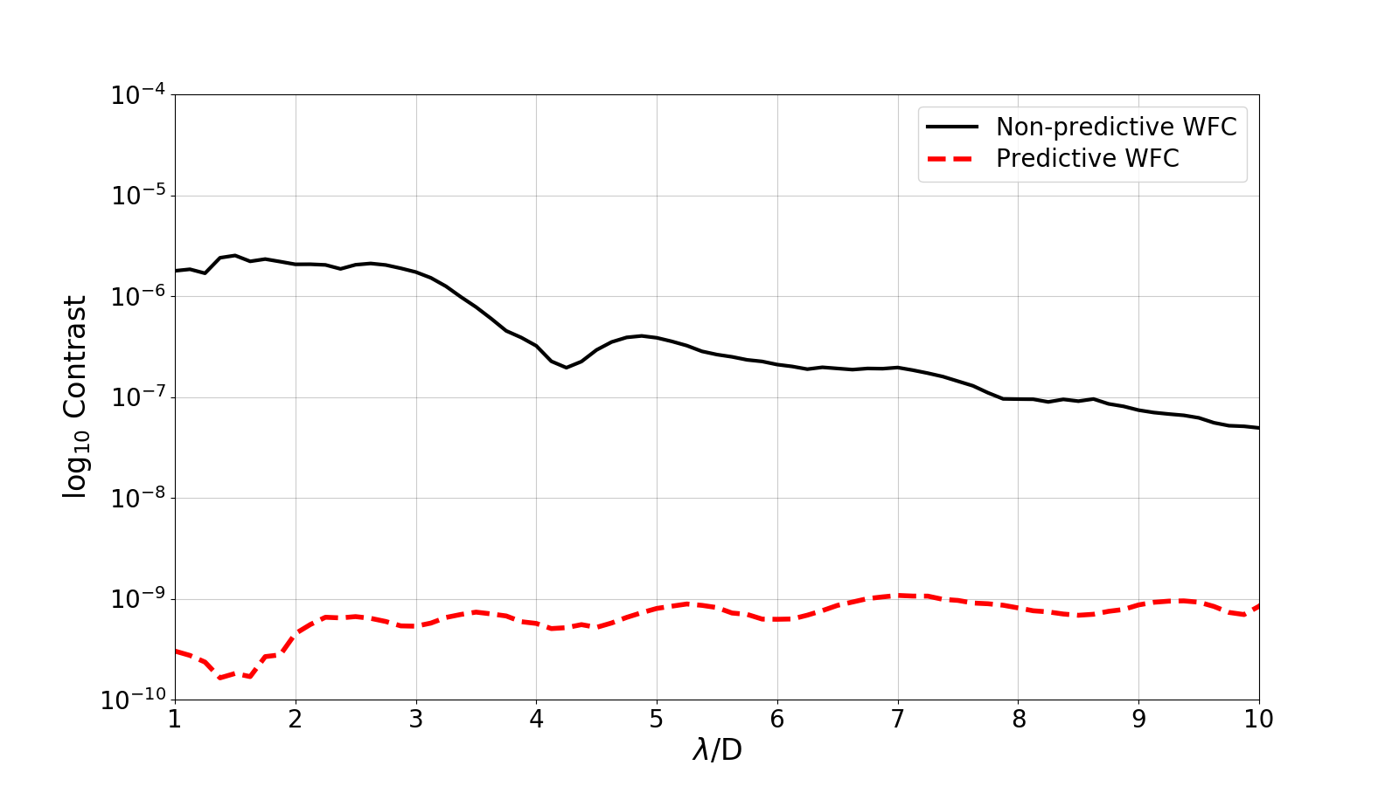
Notes:
Say something about ideal case
Mention that the top isn’t crazy for real things

Slide 28
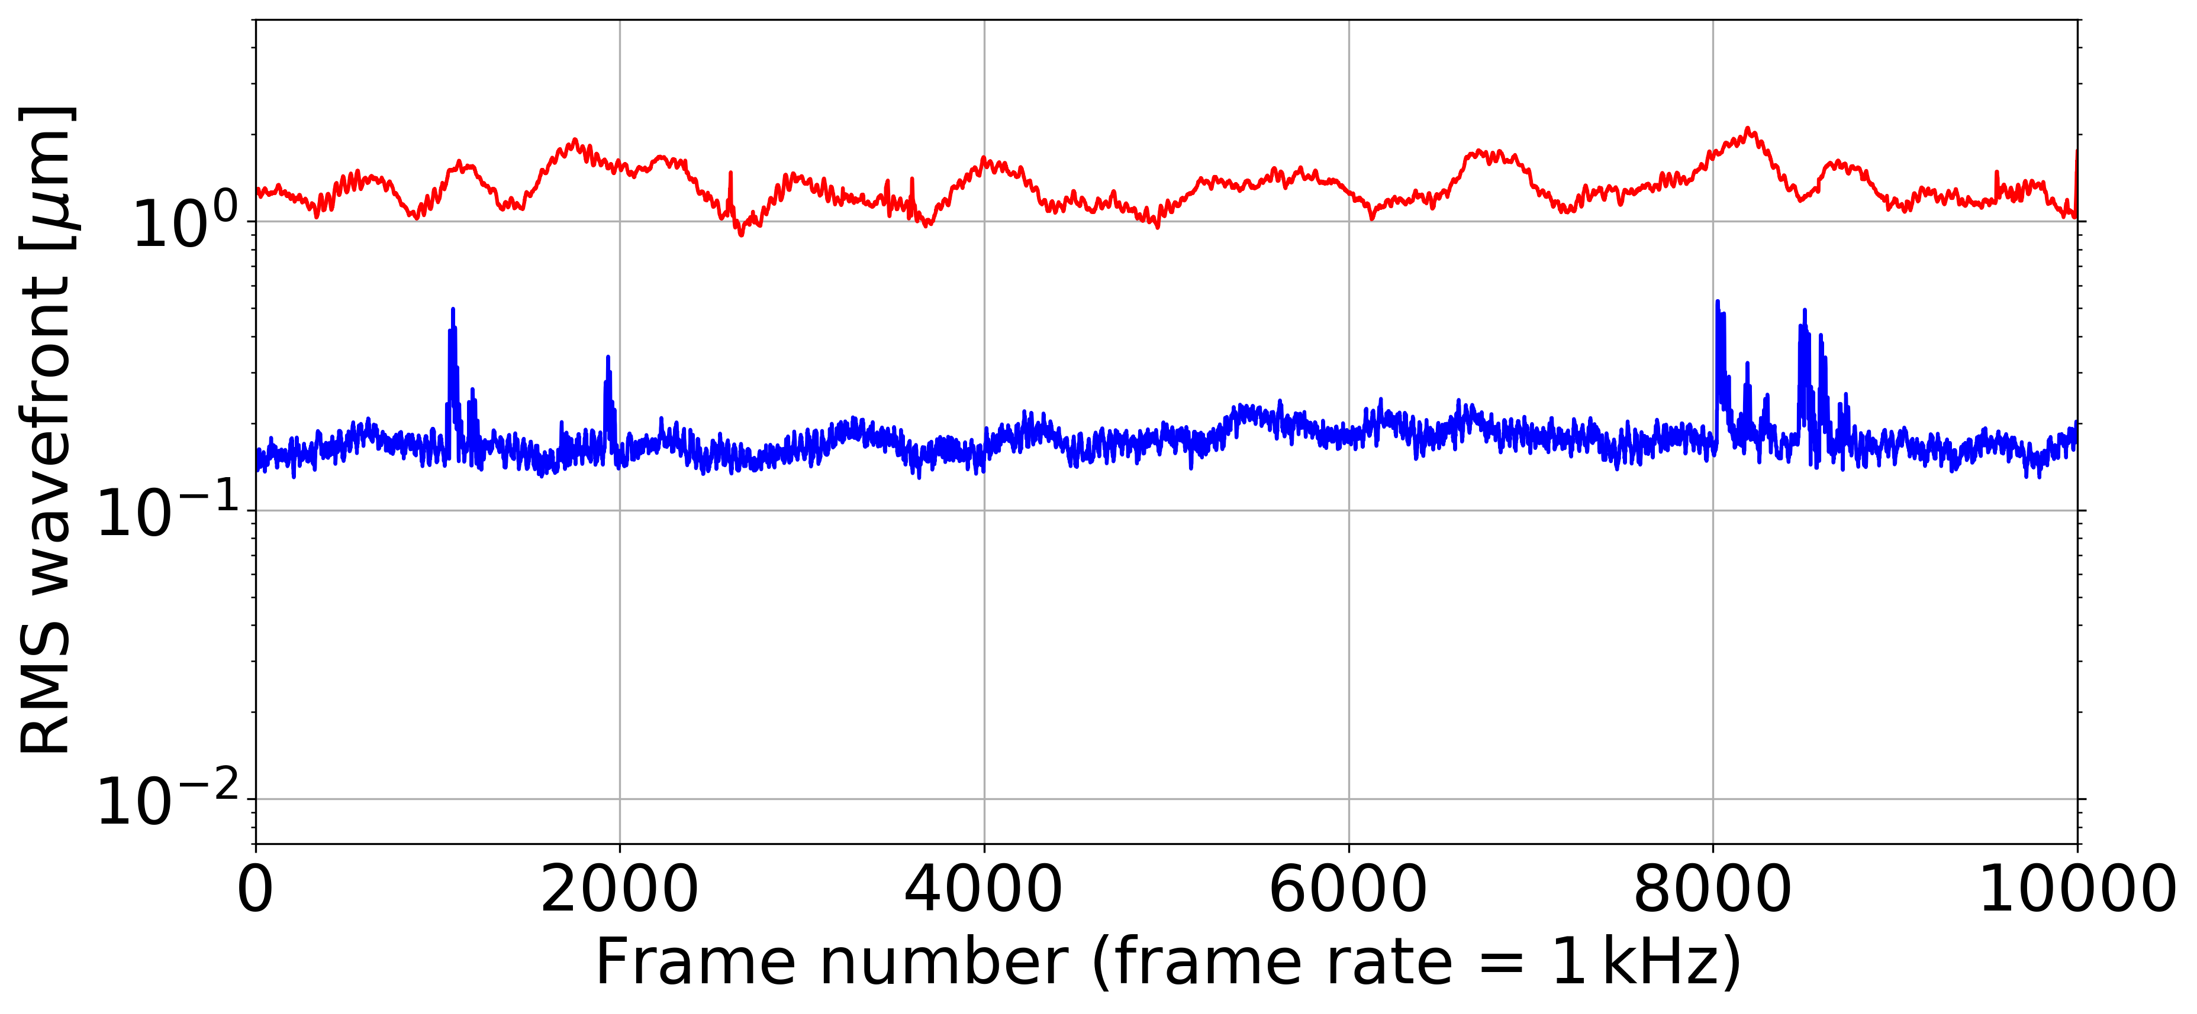

Slide 29
Summary of Wavefront Reconstruction
Because most wavefront sensors don’t measure the phase directly, we must “reconstruct” the phase based on our information from the wavefront sensor
Usually, WF reconstruction is done with a matrix
  We can reconstruct the wavefront “zonally” in DM actuator space or “modally” e.g. in Zernike modes
  We typically measure the interaction matrix experimentally
  We compute the pseudo-inverse of the interaction matrix to find the reconstruction matrix
Predictive WFC is motivated by the time delay between reconstructing the phase and correcting the WF with the DM (often a few milliseconds or less)

